Slide 1
Introduction to SQL: Structured Query Language By AppJedi
Session Five
January 16, 2025

Slide 2
Review Syllabus.
Goals:
Basic SELECT statement for data retrieval.
Where clause filter rows.
Using wild cards.
Specifying columns and column aliases.
Order by (Sorting).
Limiting number of rows.
SQL Operators: Arithmetic, Comparison, Logical
SQL Null Functions:
Set Operations: UNION, UNION ALL, INTERSECT, EXCEPT
Sub queries.
Primary & Foreign Keys
Joins: INNER, LEFT, RIGHT, SELF, OUTER.
Aggregates: COUNT, SUM, AVG, MIN, MAX.
Group By and Having (filter).
Views.
CTE: Common Table Expression, temp tables (with)
CASE statements.
SQL Injection.
Stored Procedures.
Date functions.
String functions.
Numeric Functions.

Slide 3
Views:
A Database View is a virtual table that provides a user-friendly representation of data from one or more underlying tables. It simplifies complex queries and data access
Syntax:
CREATE VIEW view_name AS
SELECT [* | columns, …] FROM table

Slide 4
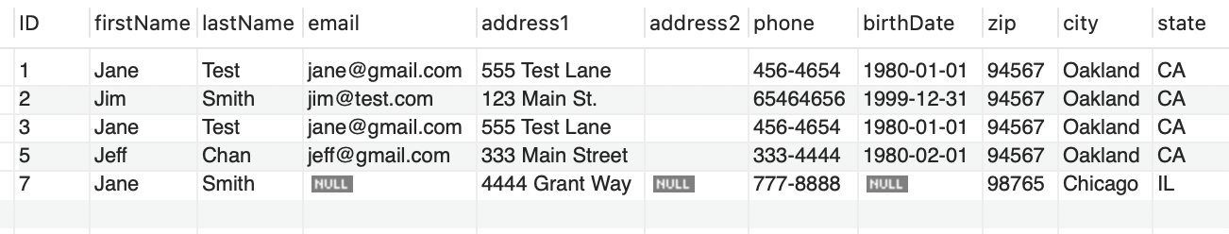
CREATE VIEW EXAMPLE:
CREATE VIEW view_customer_city AS
SELECT c.* , cz.city, state
FROM customer c
JOIN city cz ON c.zip=cz.zip;

Slide 5
Benefits:
Simplifies complex queries.
Data access, use can be granted access to a view but not the underlying tables.
Include only the columns and rows necessary, hiding sensitive data.
Abstraction. Hides the source tables & columns from prying eyes.
Can include derived or calculated data including aggregates.
Limit access to third parties, API’s and client apps.

Slide 6
COMPLEX QUERY:
CREATE VIEW view_customer_purchases AS
SELECT
c.ID, c.firstName, c.lastName, c.email,
c.address1,c.phone,c.birthDate,
c.zip,city.city,city.state,
o.datePlaced, o.dateShipped,
o.status,ol.quantity,
p.name AS `Product Name`
FROM customer c
JOIN city ON c.zip = city.zip
LEFT JOIN `order` o ON c.ID = o.customerID
JOIN orderline ol ON o.ID = ol.orderID
JOIN product p ON ol.productID = p.ID

Slide 7
CREATE A VIEW of a COMPLEX QUERY:
CREATE VIEW view_sales_report AS
SELECT `type`,ShortDescription,
COUNT(*) AS `Total Sales by group`,
SUM(SalePrice) AS `Total Sales Price`,
AVG(SalePrice) AS `Average Sale Price`,
MIN(SalePrice) AS `Min Sale Price`,
MAX(SalePrice) AS `Max Sale Price`
FROM products
GROUP BY `type`,ShortDescription
HAVING SUM(SalePrice)>0

Slide 8
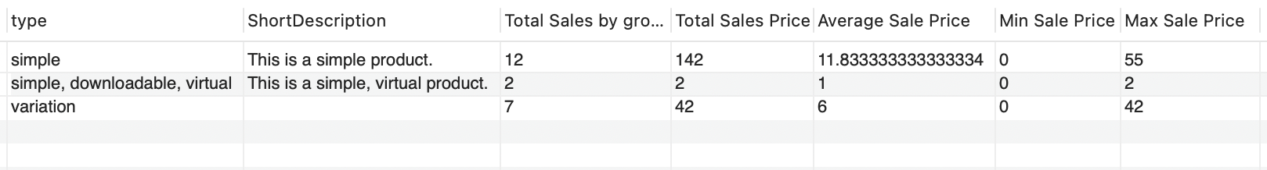
Restrict columns
In the prior view only the columns type and ShortDescription are included in the SELECT part, the other columns are all calculated aggregate columns.

Slide 9
Derived/Calculated columns
COUNT(0) AS `Total Sales by group`,
SUM(`appjedin_student_temp`.`products`.`SalePrice`) AS `Total Sales Price`,
AVG(`appjedin_student_temp`.`products`.`SalePrice`) AS `Average Sale Price`,
MIN(`appjedin_student_temp`.`products`.`SalePrice`) AS `Min Sale Price`,
MAX(`appjedin_student_temp`.`products`.`SalePrice`) AS `Max Sale Price`

Slide 10
Calculated columns
SELECT `type`,ShortDescription,
COUNT(*) AS `Total Sales by group`,
SUM(SalePrice) AS `Total Sales Price`,
AVG(SalePrice) AS `Average Sale Price`,
MIN(SalePrice) AS `Min Sale Price`,
MAX(SalePrice) AS `Max Sale Price`
FROM appjedin_student_temp.products
GROUP BY `type`,ShortDescription
HAVING SUM(SalePrice)>0

Slide 11
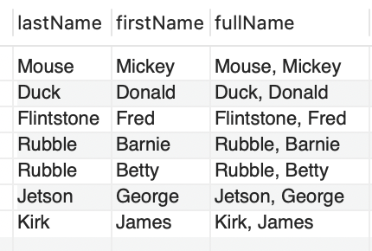
Derived Columns
Like calculated columns do not exist as a raw data column but are created from raw data columns just not numeric.
SELECT lastName, firstName, CONCAT (lastName, ', ',firstName) AS fullName
FROM employees;

Slide 12
With or CTE: Common Table Expressions
WITH CTE_products AS (
SELECT
o.customerId,
datePlaced,
dateShipped ,
o.id AS orderId,
o.`status` ,
ol.`quantity` ,
p.currentPrice,
`p`.`name` AS `Product Name`
FROM `order` o
JOIN orderline ol ON o.ID = ol.orderID
JOIN product p ON ol.productID = p.ID)
Can be used in place of a sub-query.
Creates a temporary virtual table in memory.

Slide 13
CTE Example:
WITH CTE_products AS (
SELECT
o.customerId,
datePlaced,
dateShipped ,
o.id AS orderId,
o.`status` ,
ol.`quantity` ,
p.currentPrice,
`p`.`name` AS `Product Name`
FROM `order` o
JOIN orderline ol ON o.ID = ol.orderID
JOIN product p ON ol.productID = p.ID)
SELECT c.*, p.*
FROM customer c
JOIN CTE_products p ON c.id = p.customerId;

Slide 14
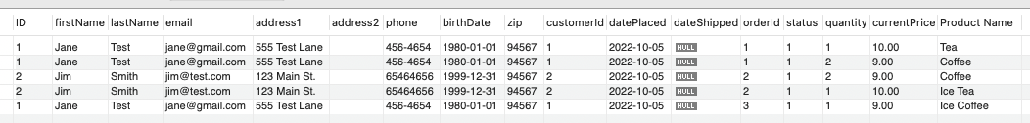
AS CTE (WITH)

Slide 15
CTE (WITH) Advantages:
Simplicity
Performance CTE are held in memory so less I/O.
CTEs make code more readable. And readability makes queries easier to debug.
CTEs can reference the results multiple times throughout the query. By storing the results of the subquery, you can reuse them throughout a larger query.
CTEs can help you perform multi-level aggregations.

Slide 16
Saving CTE using Stored Procedure
CREATE PROCEDURE usp_cte_example ()
WITH CTE_products AS (
SELECT
o.customerId, datePlaced,
dateShipped , o.id AS orderId,
o.`status` , ol.`quantity` ,
p.currentPrice,`p`.`name` AS `Product Name`
FROM `order` o
JOIN orderline ol ON o.ID = ol.orderID
JOIN product p ON ol.productID = p.ID)
SELECT c.*, p.*
FROM customer c
JOIN CTE_products p ON c.id = p.customerId;
END

Slide 17
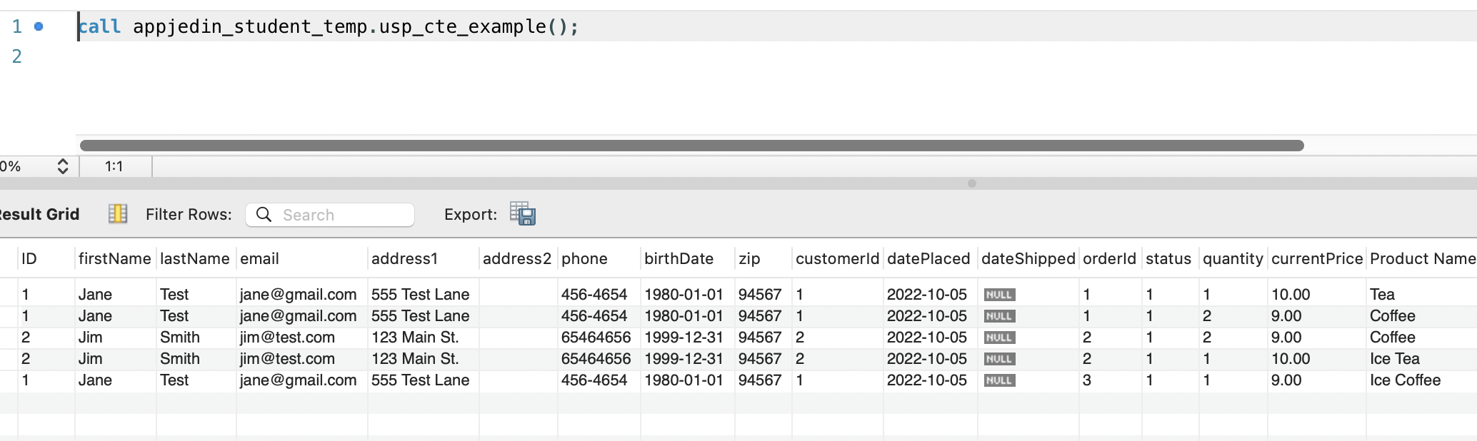
Calling the Stored Procedure:

Slide 18
CASE
CASE WHEN condition1 THEN result1 WHEN condition2 THEN result2 WHEN conditionN THEN resultN ELSE result END;
Exercise: Try the above query with different columns, tables.

Slide 19
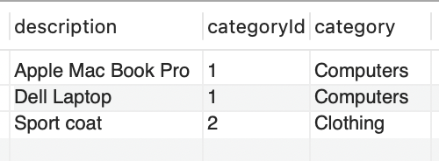
CASE Example:
SELECT description,categoryId,
CASE
WHEN categoryId=1 THEN 'Computers'
WHEN categoryId=2 THEN 'Clothing'
ELSE 'Other'
END AS category
FROM items;

Slide 20
NEXT
Questions?
More on stored procedures.
Date functions.
String functions.
Numeric Functions.
Please like and subscribe.
Visit me at www.appjedi.net

